Slide 2
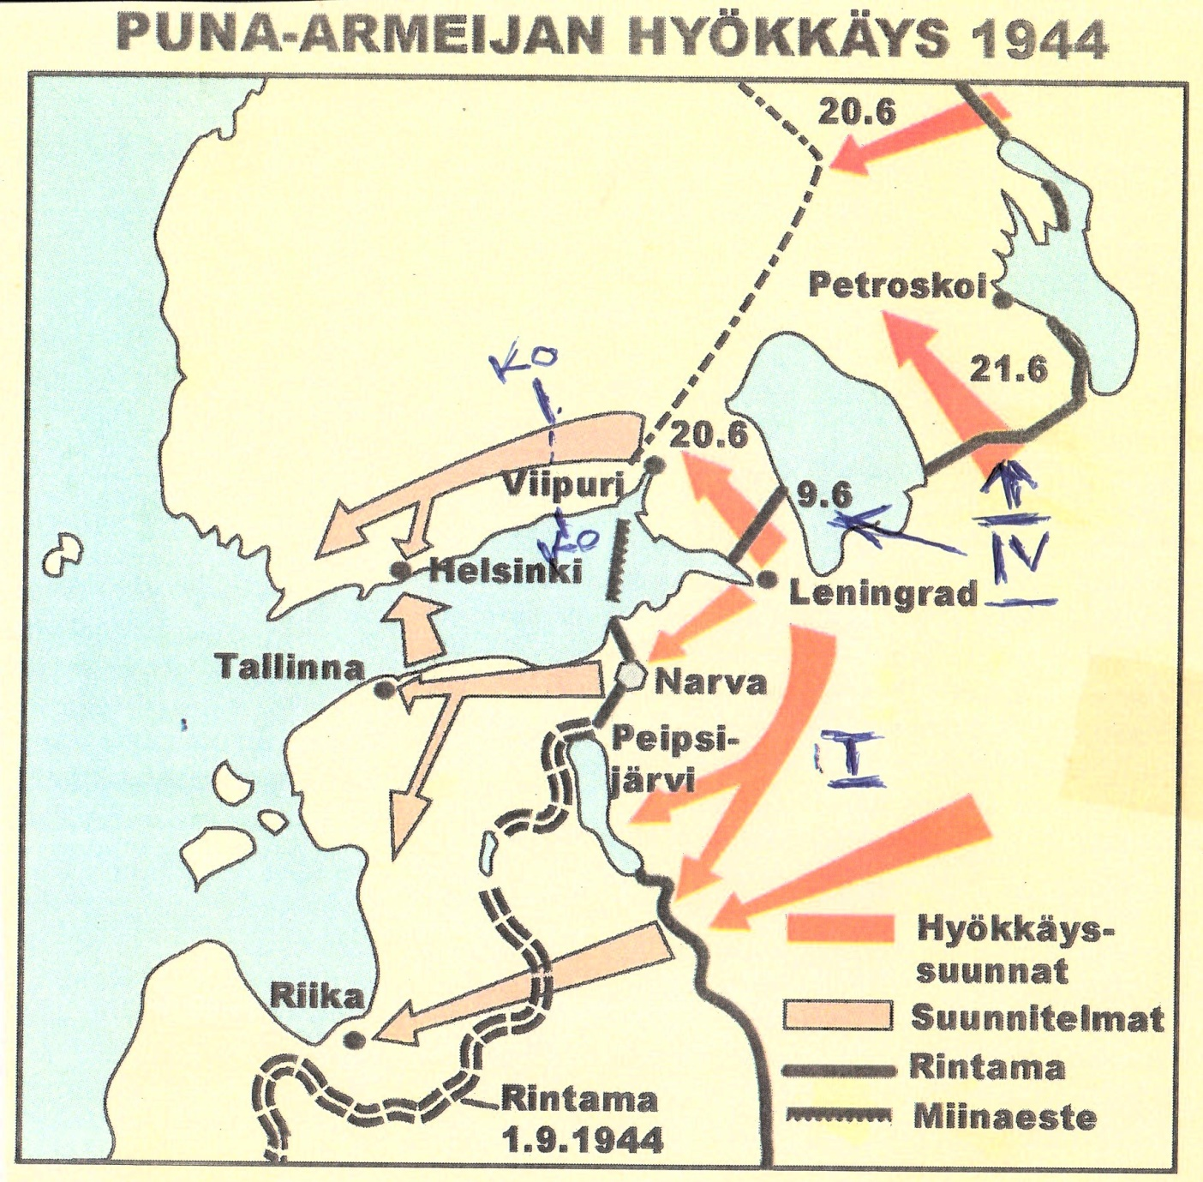

Slide 3
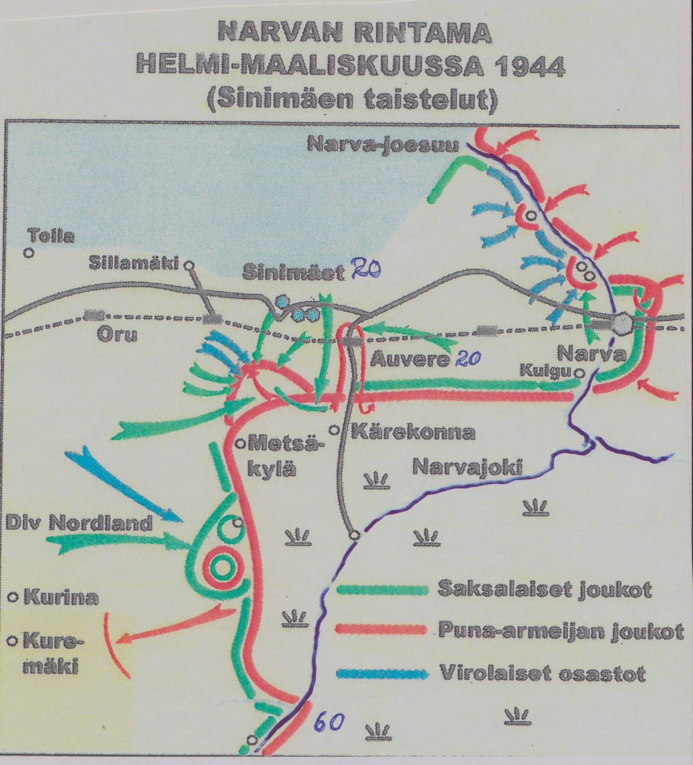

Slide 4
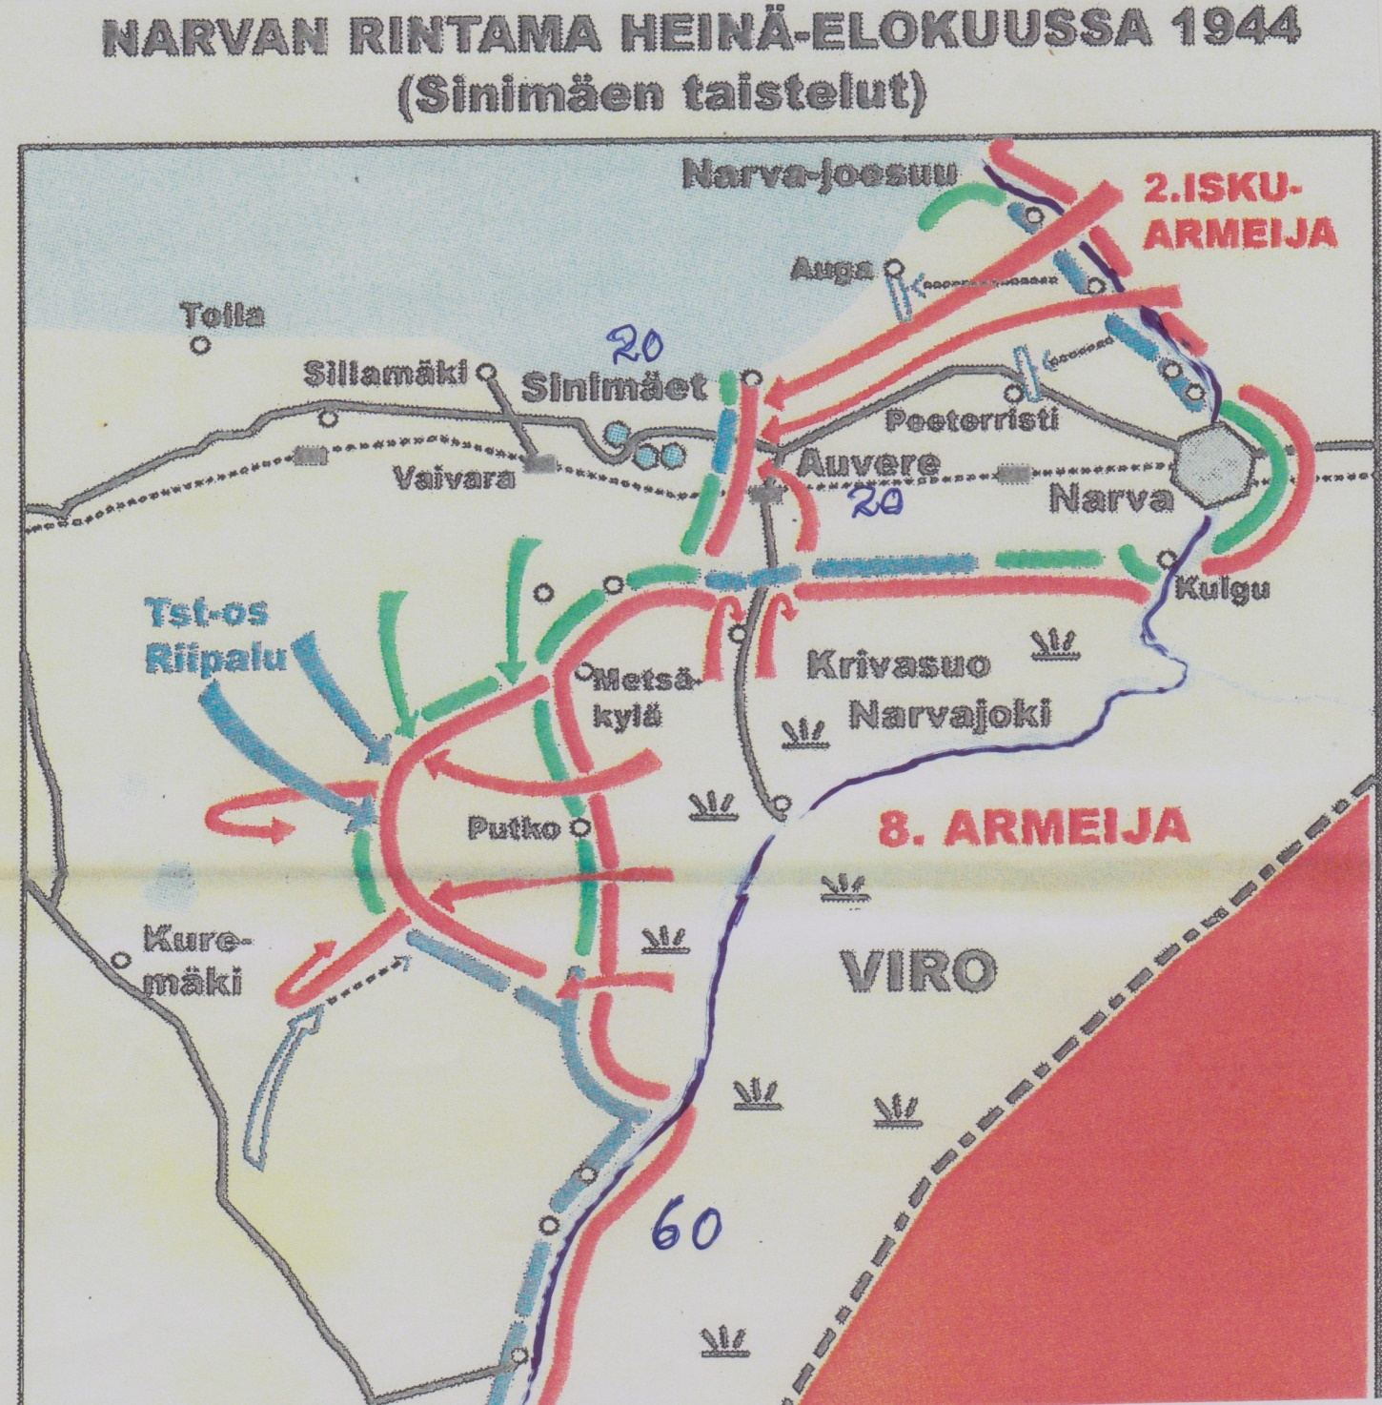

Slide 5
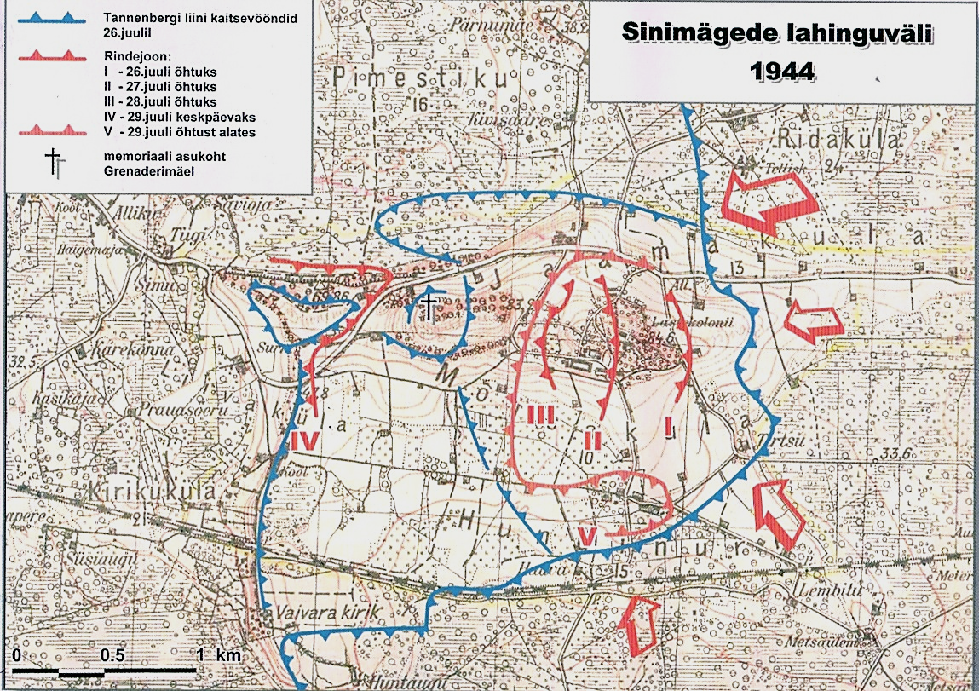
1. Tornimäki
2. Krenatoorin mäki
3. Lastenkodin mäki
1
2
3
MK

Slide 6
